Slide 1
SharePoint Online page load performance troubleshooting
Speaker Name

Slide 3
Objectives
After completing this section, you will:
Know about tools that can be used to help capture and analyze SharePoint Online page performance issues
Understand the importance of content delivery networks (CDNs) and how to configure SharePoint Online to use them
Know how to configure and use of the Microsoft 365 Content Delivery Network

Slide 4
Troubleshooting and diagnosing page load performance issues with SharePoint Online

Slide 5
Microsoft Edge Developer Tools
The Microsoft Edge DevTools are built with TypeScript, powered by open source, and optimized for modern front-end workflows
Using the Edge DevTools, you can debug, test, and speed up your webpages. Whether you need to fine tune your CSS layout, get response times per component on a page, or find a memory leak
Also available as a standalone Windows 10 app in the Microsoft Store https://www.microsoft.com/en-us/store/p/microsoft-edge-devtools-preview/9mzbfrmz0mnj
Press the F12 key on your keyboard to open the tools. If your keyboard doesn't have function keys, you can use the Tools menu
Notes:
TypeScript is. a typed superset of JavaScript that compiles to plain JavaScript. TypeScript compiles to clean, simple JavaScript code which runs on any browser, in Node.js, or in any JavaScript engine that supports ECMAScript 3 (or newer).
ChakraCore is the core part of Chakra, the high-performance JavaScript engine that powers Microsoft Edge and Windows applications written in HTML/CSS/JS. ChakraCore supports Just-in-time (JIT) compilation of JavaScript for x86/x64/ARM, garbage collection, and a wide range of the latest JavaScript features. ChakraCore also supports the JavaScript Runtime (JSRT) APIs, which allows you to easily embed ChakraCore in your applications.

Slide 6

Microsoft Edge browser Developer Tools
Elements panel to edit HTML and CSS, inspect accessibility properties, view event listeners, and set DOM mutation breakpoints
Console to view and filter log messages, inspect JavaScript objects and DOM nodes, and run JavaScript in the context of the selected window or frame
Debugger to step through code, set watches and breakpoints, live edit your code, and inspect your web storage and cookie caches
Network panel to monitor and inspect requests and responses from the network and browser cache
Performance panel to profile the time and system resources required by your site
Memory panel to measure your use of memory resources and compare heap snapshots at different states of code execution
Emulation panel to test your site with different browser profiles, screen resolutions, and GPS location coordinates
The stand-alone version of Microsoft Edge DevTools also includes
A Storage panel for inspecting and managing your web storage, IndexedDB, cookies and cache data
A Service Workers panel for managing and debugging your service workers
Notes:
NOTE: A Service Worker is a script that your browser runs in the background, separate from a web page, opening the door to features that don't need a web page or user interaction.

Slide 7
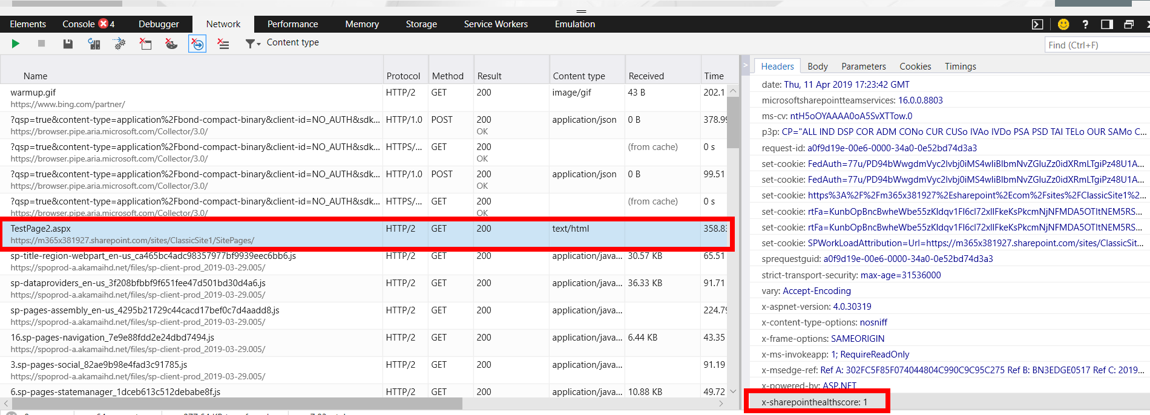
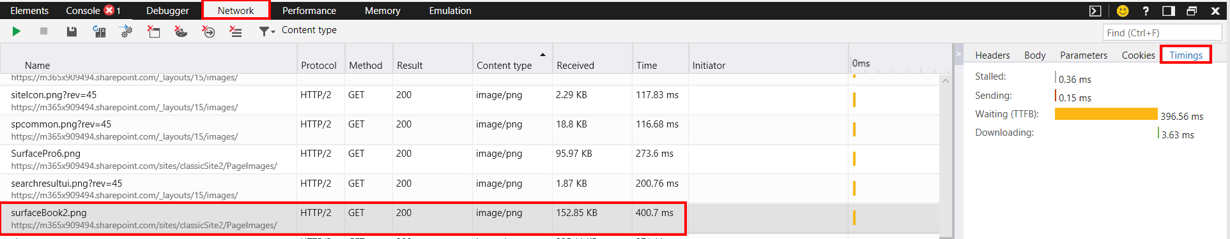
Microsoft Edge Developer Tools – Network panel
The Network panel is commonly used to monitor, inspect and profile requests and responses sent over the wire.
Browse a record of all resource requests made by a page.
Measure the load time of your page, and individual files and items on page
Inspect the Headers to retrieve the SharePointHealthScore of each request
Inspect the Timing to retrieve TTFB (Time to first byte) and overall load time for a page and individual elements on a page.
Notes:
X-SharePointHealthScore Header: The server can monitor the current load and its ability to process requests. If it monitors the load, it can return the load information to the client in a X-SharePointHealthScore header. This header specifies a value between 0 and 10, where 0 represents a low load and a high ability to process requests and 10 represents a high load and that the server is throttling requests to maintain adequate throughput. https://docs.microsoft.com/en-us/openspecs/sharepoint_protocols/ms-wsshp/c60ddeb6-4113-4a73-9e97-26b5c3907d33

Slide 8

Page Diagnostic tool for SharePoint Online
Use the Page Diagnostic tool to analyze your modern and classic pages against a pre-defined set of performance criteria
Version 2.0.0 (and later) of the Page Diagnostics tool for SharePoint is a browser extension for Chrome and Microsoft Edge version 77 and later. ​
Version 2.0.0 and later includes support for modern pages and classic pages​.
Microsoft does not read the data or websites you visit, and we do not capture any personal information, website or download information with this tool. ​
The only information logged by the tool is the Tenant name, Rule count and whether the support logging option has been utilized when the tool is run​.
Page diagnostic tool can also be found at Microsoft Edge Add on site
Page diagnostics for SharePoint - Microsoft Edge Addons

Slide 9
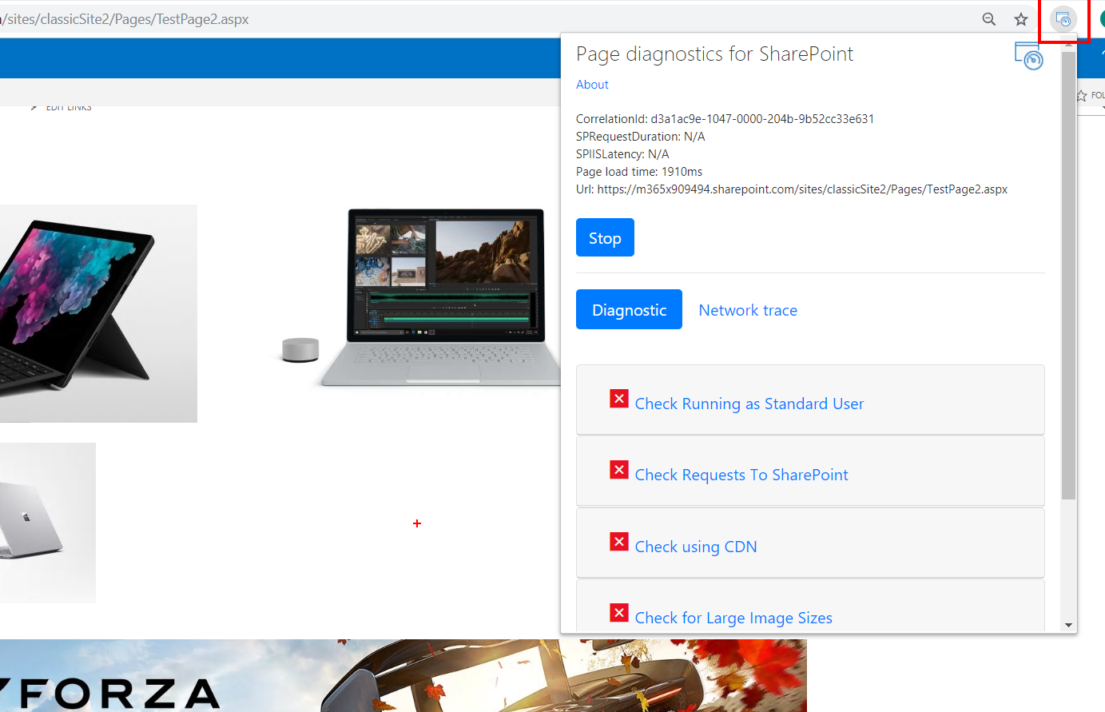
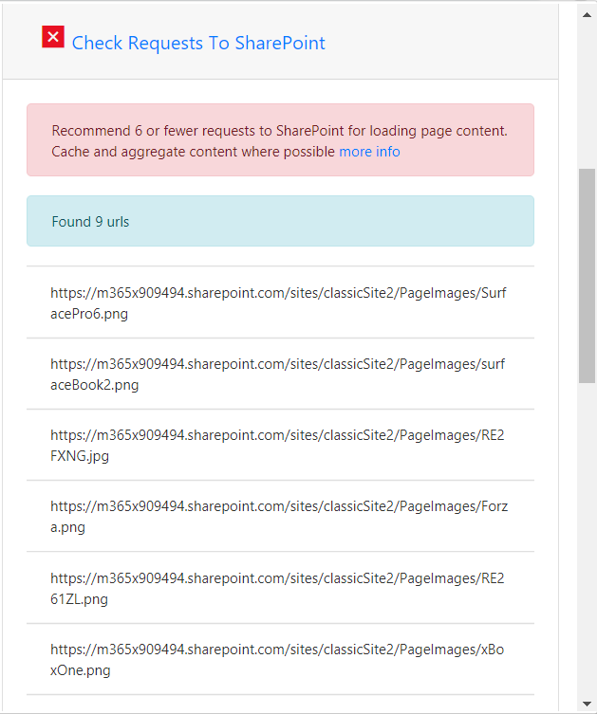
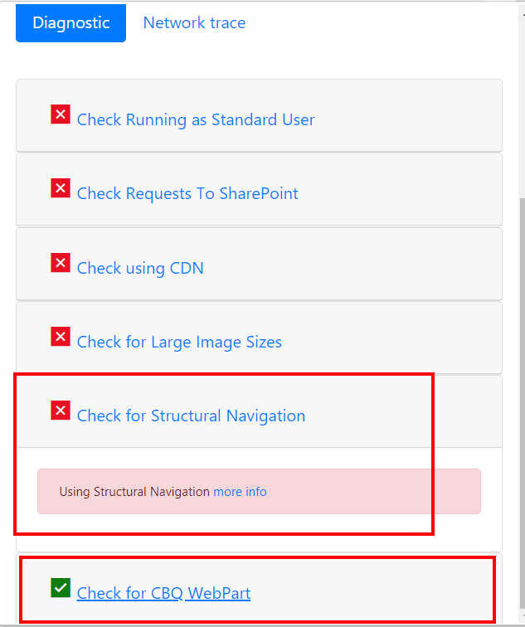
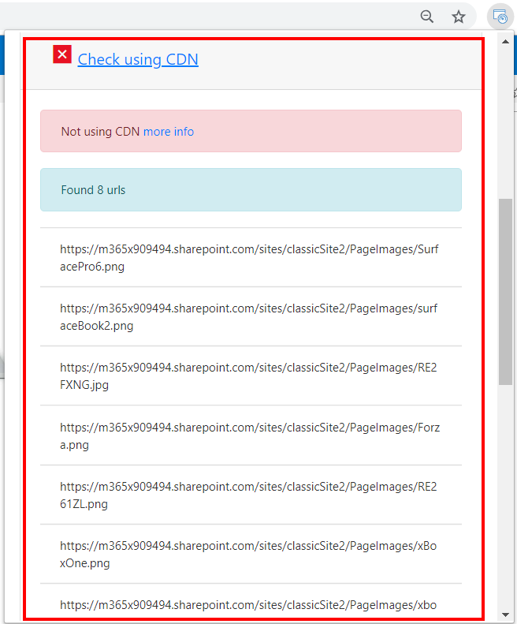
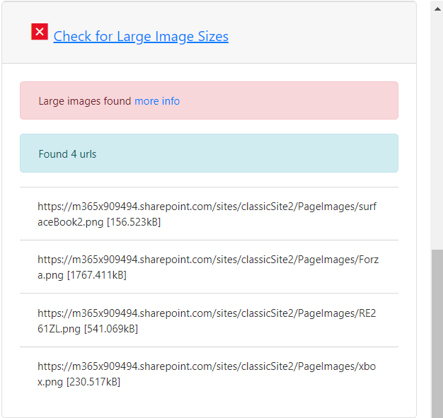
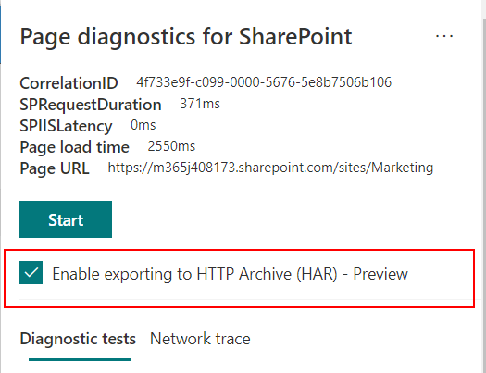
Page Diagnostic tool for SharePoint Online
The Correlation ID, SPRequestDuration, SPIISLatency, Page load time, and URL details are informational
Check Requests to SharePoint -verifies the number of requests being made to SharePoint.
Check using CDN - flags items on page that could be served from CDN
Web parts using iFrames – Flagged if page contains three or more web parts using iFrames
Check for Large Image Sizes – Flags Images / image renditions larger than 300kb Option to export report to HTTP Archive file – helpful when working with Microsoft Support
Notes:
Check Running as Standard User Checking page performance should not be performed when logged in as a Service Account, Administrator or Site Collection Administrator, or any account with elevated privileges. Additional scripts and functionality are loaded specifically for those types of accounts, so the results will not be a true representation of page performance.
Check Requests to SharePoint The amount of data and requests made to the server should be limited as an overloaded page will experience poor performance. This check verifies the number of requests being made to SharePoint and will advise when the requests exceed 6 requests. Most requests should be cached and therefore not called for every page load. Cache should be setup and utilized for at least 15 minutes to reduce the amount of calls to a page by each and every User. This is a common problem and in most cases data only changes daily but the page checks and fetches data each time for each page for each user which is often unnecessary.
Check using CDNs Content Delivery networks (CDNs) have been provided by Microsoft and the ones referred to here are the SharePoint Online Content Delivery Networks. There are multiple types available as well as different CDN services like SharePoint CDNs and then CDNs in Azure. Use the following guidance.
Check for Large Image Sizes Images should be optimized for web by utilizing better web types like PNG. Image renditions should also be utilized and is available in SharePoint directly. Images / image renditions larger than 100kb will be highlighted as not optimized for web. Use the following guidance for optimizing images.
https://docs.microsoft.com/en-us/office365/enterprise/modern-image-optimization
Check for Structural Navigation Structural Navigation was originally designed for use in SharePoint on-Premises where object cache could be utilized. Structural Navigation is not recommended for use in SharePoint Online and should be changed to Managed Navigation or a Custom Provider. Use the following guidance for optimizing navigation.﻿
Check for CBQ WebPart (CBQ - Content by Query WebPart) The Content by Query WebPart generates a high SQL load as it traverses all items in the query for each and every page load, for each User. Unlike an on-Premises installation, there is no cache available to limit the number of queries needed to populate this WebPart. As such CBQ performs slowly and impacts overall page performance which is why it should not be utilized. Please use the Content Search WebPart (CSWP) as the replacement for the Content Query WebPart. Use the following guidance related to the Content Search WebPart.

Slide 10
Demonstration
Demo using the Microsoft Edge Developer Tools
Download and demostrate the Page diagnostic tool for SharePoint Online
Notes:
Use the network panel in the Microsoft Edge Developer tools to analyze network traffic of a classic page in SharePoint Online
Point out the overall load time of the home.aspx page or landing page you are demo’ing
Add some images to the page and view load times of the images
Point out where to see the SPRequestGUID (aka Correlation Id) in the Headers tab in the Network panel
Point out the Timings tab in the Network panel and the Waiting (TTFB) value
Download and demonstrate running the Page diagnostic tool for SharePoint Online against a classic site page using Google Chrome

Slide 11
Using the Content Delivery Network (CDN)

Slide 12
Content Delivery Network
The Microsoft 365 CDN is included as part of your SharePoint Online subscription. You don't have to pay extra for it.
You can host static assets in the Microsoft 365 content delivery network (CDN) to provide better performance for your SharePoint Online pages.
Static assets are files that don't change very often, like images, video and audio, style sheets, fonts, and JavaScript files.
The CDN works as a geographically distributed caching proxy, by caching static assets closer to the browsers requesting them.
Notes:
The Microsoft 365 CDN is included as part of your SharePoint Online subscription. You don't have to pay extra for it. Microsoft 365 provides support for both private and public access and allows you to host static assets in multiple locations, or origins. The Microsoft 365 CDN is not the same as the Azure CDN. If you need more information about why to use a CDN or about general CDN concepts, see https://docs.microsoft.com/en-us/office365/enterprise/content-delivery-networks

Slide 13
CDN Planning
Determine
Determine which static assets you want to host on the Microsoft 365 CDN
Typical static asset file types hosted on CDN are .css, .eot, .gif, .ico, .jpeg, .jpg, .js,.png, .svg, .ttf, and .woff
Determine
Determine where you want to store your assets
The CDN fetches your assets from a location called an origin
This origin is a folder or SharePoint library
Determine
Determine whether the assets should be made public or kept private. You do this when you choose whether each origin should be public or private
Have
You can have multiple origins in which some are public, and some are private

Slide 14
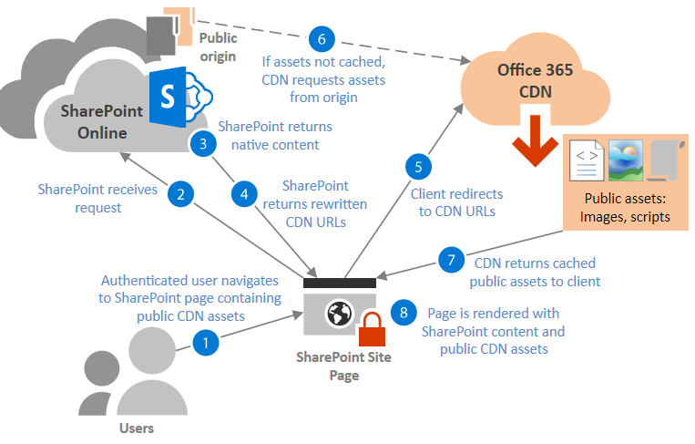
Public CDN origins
Public origins within the Microsoft 365 CDN are accessible anonymously and hosted assets can be accessed by anyone who has the URL to the asset.
Because access to content in public origins is anonymous, you should only use them to cache non-sensitive generic content such as JavaScript files, scripts, icons and images
Notes:
Using assets in public origins
The Publishing feature in SharePoint Online automatically rewrites URLs of assets stored in public origins to their CDN equivalents so that assets are served from the CDN service instead of SharePoint.
If your origin is in a site with the Publishing feature enabled, and the assets you want to offload to the CDN are in one of the following categories, SharePoint will automatically rewrite URLs for assets in the origin, provided that the asset has not been excluded by a CDN policy.
The following is an overview of which links are automatically rewritten by the SharePoint Publishing feature:
IMG/LINK/CSS URLs in classic publishing page HTML responses
This includes images added by authors within the HTML content of a page
Picture Library SlideShow webpart image URLs
Image fields in SPList REST API (RenderListDataAsStream) results
Use the new property ImageFieldsToTryRewriteToCdnUrls to provide a comma separated list of fields
Supports hyperlink fields and PublishingImage fields
SharePoint image renditions

Slide 15
Attributes and advantages of hosting assets in a public origin
Public CDN
The Publishing feature in classic SharePoint Online sites automatically rewrites URLs of assets stored in public origins to their CDN equivalents so that assets are served from the CDN service instead of SharePoint.
The page hosting the assets must be created and exist in the /Pages library of the site
The page must be checked-in and published
Images must be reference from directly within the HTML of the page and not referenced from a .css or .master page.
If the Publishing feature is not enabled on a site hosting a public origin, you can manually construct URLs to the CDN location of the assets and use these URLs in your content
https://publiccdn.sharepointonline.com/<TenantHostName>/sites/site/library/asset.png
If you remove an asset from a public origin, the asset may continue to be available for up to 30 days from the cache; however, you will invalidate links to the asset in the CDN within 15 minutes
Notes:
Using assets in public origins
The Publishing feature in SharePoint Online automatically rewrites URLs of assets stored in public origins to their CDN equivalents so that assets are served from the CDN service instead of SharePoint.
If your origin is in a site with the Publishing feature enabled, and the assets you want to offload to the CDN are in one of the following categories, SharePoint will automatically rewrite URLs for assets in the origin, provided that the asset has not been excluded by a CDN policy.
The following is an overview of which links are automatically rewritten by the SharePoint Publishing feature:
IMG/LINK/CSS URLs in classic publishing page HTML responses
This includes images added by authors within the HTML content of a page
Picture Library SlideShow webpart image URLs
Image fields in SPList REST API (RenderListDataAsStream) results
Use the new property ImageFieldsToTryRewriteToCdnUrls to provide a comma separated list of fields
Supports hyperlink fields and PublishingImage fields
SharePoint image renditions
When you host style sheets (CSS files) in a public origin, you can use relative paths and URIs within the code. This means that you can reference the location of background images and other objects relative to the location of the asset that's calling it.
The default file types that are included for public origins are .css, .eot, .gif, .ico, .jpeg, .jpg, .js, .map, .png, .svg, .ttf, and .woff. You can specify additional file types.
You can configure a policy to exclude all assets that are marked as "confidential" or "restricted" within your organization, even if they are an allowed file type and are located in a public origin.

Slide 16
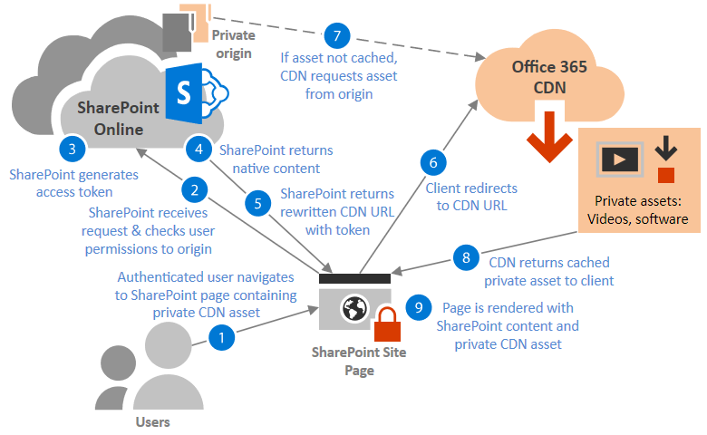
Private CDN origins
Access to content in private origins is secured by dynamically generated tokens so it can only be accessed by users with permissions to the original document library or storage location.
SharePoint Online automatically rewrites URLs for assets in private origins so requests for those assets will always be served from the CDN.

Slide 17
Attributes and advantages of hosting assets in a private origin
Access to assets in private origins in the Microsoft 365 CDN is granted by tokens generated by SharePoint Online
Anonymous access to these assets is prevented.
Users must have permission to access to the folder or library designated as the private origin
Item-level permissions are not supported for assets in private origins
Access tokens are valid for 30 to 90 minutes after they are generated to help prevent token replay attacks.
You cannot hardcode CDN URLs to assets in a private origin because the required access token that forms the last section of the URL is generated at the time the resource is requested.
Notes:
Token-based authorization in private origins
Access to assets in private origins in the Microsoft 365 CDN is granted by tokens generated by SharePoint Online. Users who already have permission to access to the folder or library designated by the origin are automatically granted tokens that permit the user to access the file based on their permission level. These access tokens are valid for 30 to 90 minutes after they are generated to help prevent token replay attacks.
Once the access token is generated, SharePoint Online returns a custom URI to the client containing two authorization parameters eat (edge authorization token) and oat (origin authorization token). The structure of each token is <'expiration time in Epoch time format'>__<'secure signature'>. For example:
HTML Copy
https://privatecdn.sharepointonline.com/contoso.sharepoint.com/sites/site1/library1/folder1/image1.jpg?eat=1486154359_cc59042c5c55c90b26a2775323c7c8112718431228fe84d568a3795a63912840&oat=1486154359_7d73c2e3ba4b7b1f97242332900616db0d4ffb04312 Note
Anyone in possession of the token can access the resource in the CDN. However, URLs containing these access tokens are only shared over HTTPS, so unless the URL is explicitly shared by an end user before the token expires, the asset won’t be accessible to unauthorized users.
Item-level permissions are not supported for assets in private origins
It is important to note that SharePoint Online does not support item-level permissions for assets in private origins.
If you remove an asset from the private origin, the asset may continue to be available for up to an hour from the cache; however, we will invalidate links to the asset in the CDN within 15 minutes.
The default file types that are included for private origins are .gif, .ico, .jpeg, .jpg, .js, and .png. You can specify additional file types.
Just like public origins, you can configure a policy to exclude assets that have been identified by site classifications that you specify even if you use wildcards to include all assets within a folder or Site Library.
For additional information see https://docs.microsoft.com/en-us/office365/enterprise/use-office-365-cdn-with-spo#plan-for-deployment-of-the-office-365-cdn

Slide 18
Enabling the Microsoft 365 CDN in your tenant
Set-SPOTenantCdnEnabled -CdnType <Public | Private | Both> -Enable $true
Set-SPOTenantCdnEnabled -CdnType Both -Enable $true –NoDefaultOrigins
Set-SPOTenantCdnEnabled -CdnType Both -Enable $true
Set-SPOTenantCdnEnabled -CdnType Public -Enable $true
Set-SPOTenantCdnEnabled -CdnType Private -Enable $true
Notes:
To enable your organization to use the Microsoft 365 CDN
Use the Set-SPOTenantCdnEnabled cmdlet to enable your organization to use the Microsoft 365 CDN. You can enable your organization to use either public origins, private origins, or both with the CDN. You can also configure the Microsoft 365 CDN to skip the setup of default origins when you enable it. You can always add these origins later as described in this topic.
In Windows Powershell for SharePoint Online:
Copy
Set-SPOTenantCdnEnabled -CdnType <Public | Private | Both> -Enable $true For example, to enable your organization to use both public and private origins with the CDN, type the following command:
Copy
Set-SPOTenantCdnEnabled -CdnType Both -Enable $true To enable your organization to use both public and private origins with the CDN but skip setting up the default origins, type the following command:
Copy
Set-SPOTenantCdnEnabled -CdnType Both -Enable $true -NoDefaultOrigins To enable your organization to use public origins with the CDN, type the following command:
Copy
Set-SPOTenantCdnEnabled -CdnType Public -Enable $true To enable your organization to use private origins with the CDN, type the following command:
Copy
Set-SPOTenantCdnEnabled -CdnType Private -Enable $true

Slide 19
Default Microsoft 365 CDN origins
Default private origins:
*/userphoto.aspx
*/siteassets
Default public origins:
*/masterpage
*/style library

Slide 20
Adding CDN origins
Use the Add-SPOTenantCdnOrigin cmdlet to define an origin
You can define multiple origins. The origin is a URL that points to a SharePoint library or folder that contains the assets that you want to be hosted by the CDN.
Add-SPOTenantCdnOrigin -CdnType <Public | Private> -OriginUrl <path >
Where path is the path to the folder that contains the assets. You can use wildcards in addition to relative paths.
For example:
Add-SPOTenantCdnOrigin -CdnType Public -OriginUrl */masterpage
Add-SPOTenantCdnOrigin -CdnType Private -OriginUrl */publishingimages
You can also define a site collection as a private origin
Add-SPOTenantCdnOrigin -CdnType Private -OriginUrl sites/site1/siteassets

Slide 21
To change the list of file types to include in the Microsoft 365 CDN
Use the Set-SPOTenantCdnPolicy cmdlet to define static file types that can be hosted by public and private origins in the CDN. By default, common asset types are allowed, for example .css, .gif, .jpg, and .js.
Set-SPOTenantCdnPolicy -CdnType <Public | Private> -PolicyType IncludeFileExtensions -PolicyValue "<Comma-separated list of file types >"
When you define file types by using the Set-SPOTenantCdnPolicy cmdlet, you overwrite the currently defined list. If you want to add additional file types to the list, use the cmdlet first to find out what file types are already allowed and include them in the list along with your new ones.
Get-SPOTenantCdnPolicies -CdnType <Public | Private>

Slide 22
To change the list of site classifications you want to exclude from the Microsoft 365 CDN
Use the Set-SPOTenantCdnPolicy cmdlet to exclude site classifications that you do not want to make available over the CDN. By default, no site classifications are excluded
Set-SPOTenantCdnPolicy -CdnType <Public | Private> -PolicyType ExcludeRestrictedSiteClassifications -PolicyValue "<Comma-separated list of site classifications >"
To see what site classifications are currently restricted, use the Get-SPOTenantCdnPolicies cmdlet
Get-SPOTenantCdnPolicies -CdnType <Public | Private>

Slide 23
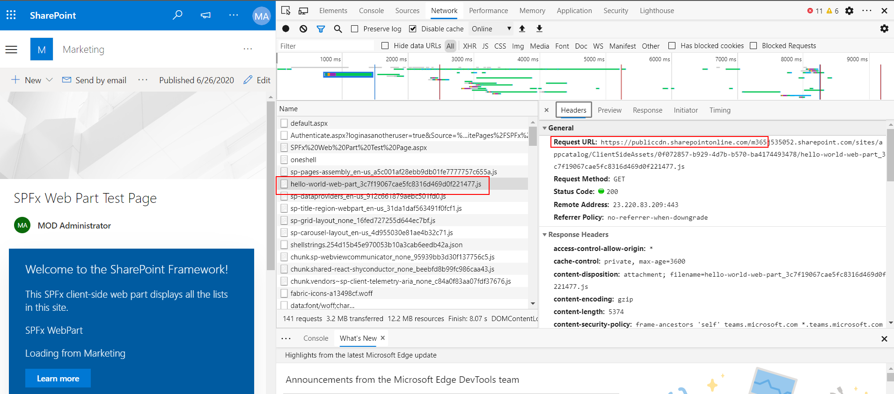
Test and Verifying CDN settings using Edge Developer tools
Sign in to the SharePoint Online site as a normal site user (non-admin)
In Microsoft Edge launch the Developer Tools
Load the page and verify images and other assets on page are being served from public or private cdn.sharepoint.com

Slide 24
Knowledge Check
What two Microsoft tools can be used to analyze and diagnose classic site page performance in SharePoint Online?
What two types of CDNs are available in Microsoft 365?
What PowerShell command is used to add a new CDN origin to a tenant?
Microsoft Edge Developer Tools and the Page Diagnostic tool for SharePoint Online
Public and Private
Add-SPOTenantCDNOrigin
Notes:
IWhat two Microsoft tools can be used to analyze and diagnose classic site page performance in SharePoint Online?
Answer: Microsoft Edge Developer Tools and the Page Diagnostic tool for SharePoint Online
What two types of CDNs are available in Microsoft 365?
Answer: Public and Private
What PowerShell command is used to add a new CDN origin to a tenant?
Answer:Add-SPOTenantCDNOrigin

Slide 25
Summary
In this lesson, you learned:
About the tools that can be used to help capture and analyze SharePoint Online page performance issues
The importance of content delivery networks (CDNs) and how to configure SharePoint Online to use them
How to configuration and use of the Microsoft 365 Content Delivery Network

Slide 26
Lab M6
Exercise 1 - Using Microsoft Diagnostic tools
Exercise 2 - Microsoft 365 Content Delivery Network

